Slide 1
One-Sample T-Test Algorithm
R. Garner, DePaul University

Slide 2
When do we do this?
When we have a sample mean to compare with a baseline mean.
For example, will a new reading curriculum that was tested on a sample actually produce better results for a population (higher mean) than the curriculum now in use?
Does the average lifetime of the light-bulb sample live up to the manufacturer’s claim?

Slide 3
Why a t-test and not a Z-test?
The t-distribution has “fatter tails” than the Z (normal) distribution.
We use the t-distribution if sample size is a bit small (30-100; by the time it is 100, t and z are virtually identical).
If we don’t know the standard deviation of the population (and we rarely do, because why would we be fussing about the mean if we already know the standard deviation?)
SPSS assumes that we are using a t-distribution.

Slide 4
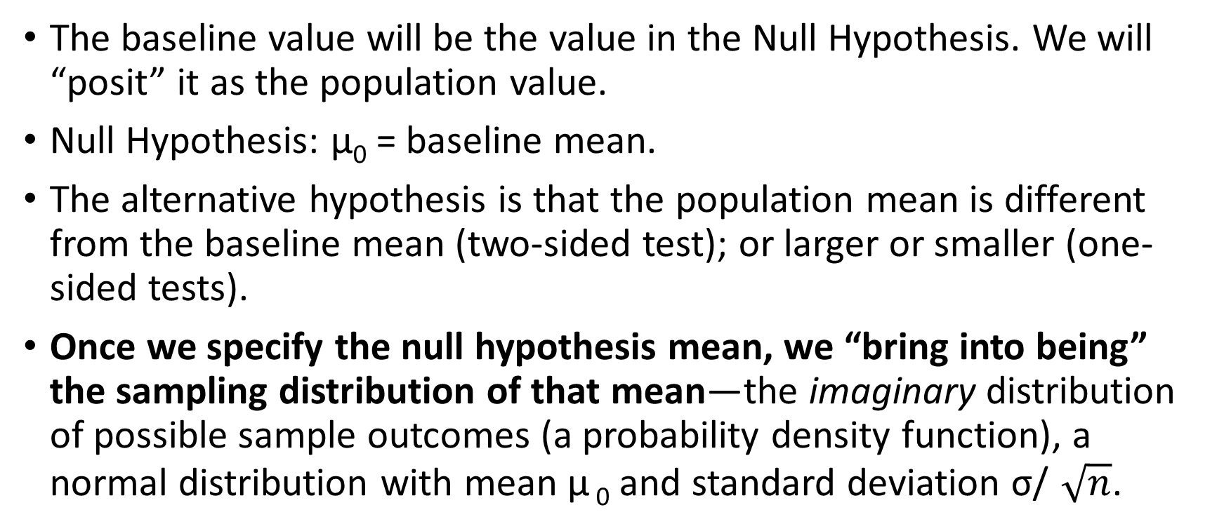
Step 1: Identify the baseline value
The baseline value will be the value in the Null Hypothesis. We will “posit” it as the population value.
Null Hypothesis: μ₀ = baseline mean.
The alternative hypothesis is that the population mean is different from the baseline mean (two-sided test); or larger or smaller (one-sided tests).
Once we specify the null hypothesis mean, we “bring into being” the sampling distribution of that mean—the imaginary distribution of possible sample outcomes (a probability density function), a normal distribution with mean μ ₀ and standard deviation σ/$\sqrt{n}$.

Slide 5
Step 1 continued: The Null Hypothesis
In the Null Hypothesis we are saying that we do NOT believe that the new reading curriculum (tested with a sample) is any better than the existing one.
We think that the population mean with the new curriculum will be exactly the same as it is with the old curriculum.
The apparent improvement in the reading-score mean that we saw in the sample only came about because by random chance we drew a sample with a result (mean) that was slightly better than the old baseline.

Slide 6
Step 2: Decide on an alpha level
The alpha level is the probability that the Null Hypothesis is true AND that we got a sample result that is very different from the Null Hypothesis.
This situation would lead to an unfortunate result: Type 1 error—rejecting the Null Hypothesis when it is true.
Conventionally, the alpha level is usually set at 0.05 (1 in 20 chance that we could get this sample result when the Null Hypothesis is true).
It is like “beyond a reasonable doubt” in criminal jurisprudence.

Slide 7
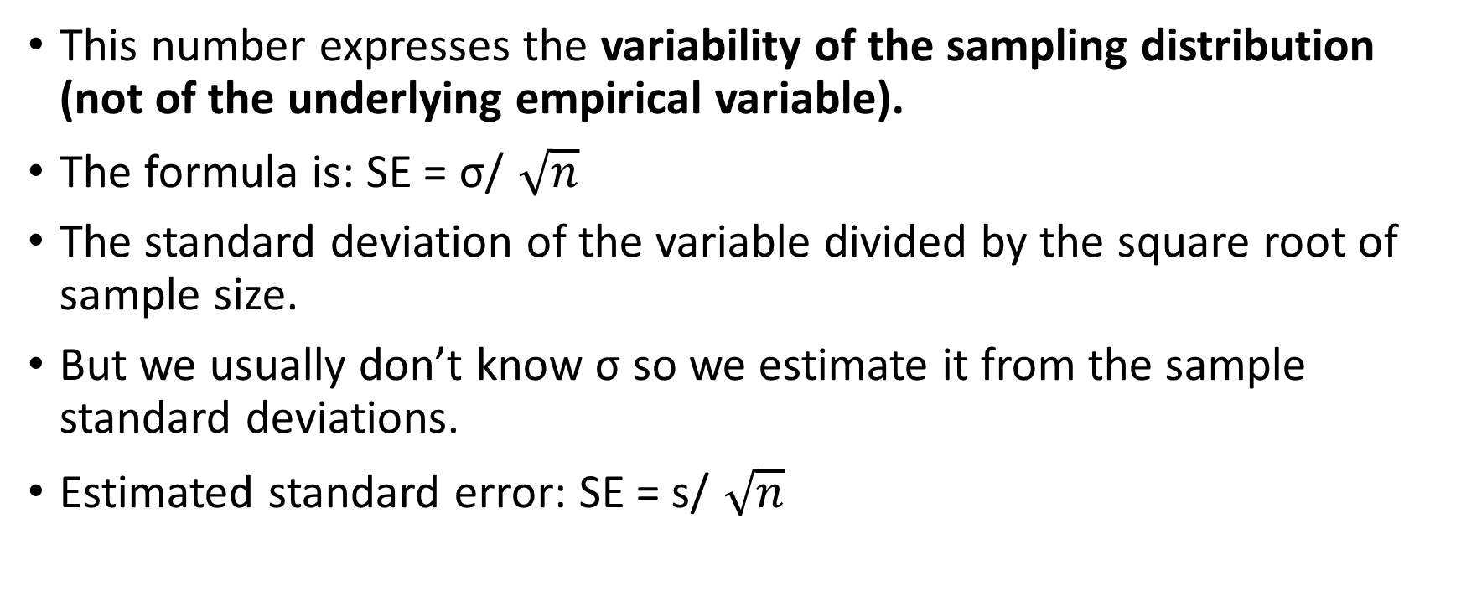
Step 3: Find the standard error for the sampling distribution
This number expresses the variability of the sampling distribution (not of the underlying empirical variable).
The formula is: SE = σ/$\sqrt{n}$
The standard deviation of the variable divided by the square root of sample size.
But we usually don’t know σ so we estimate it from the sample standard deviations.
Estimated standard error: SE = s/$\sqrt{n}$

Slide 8
Step 4: We are now ready to compute t!
T is like Z: it expresses how far an observation is from the mean of the distribution in terms of standard deviations.
In this case, how far the sample mean is from the Null Hypothesis “baseline” mean, expressed in standard errors (the standard deviation of the sampling distribution of the mean).
How likely is a result “this far out” from the Null Hypothesis mean?

Slide 9
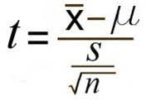
The formula

Slide 10
The algorithm (in words)
In the numerator of the formula: Compute the discrepancy between the observed sample mean and the population mean that we hypothesized for the null hypothesis.
In the denominator of the formula: place the estimated standard error. The estimated standard error is found by division:
  In the numerator, place the sample standard deviation.
  In the denominator, place the square root of sample size.

Slide 11
The formula explained
T expresses how far our sample result is from the population “baseline” mean posited in the Null Hypothesis.
Mu is the Null Hypothesis baseline mean. It is the mean in the population.
The numerator expresses the difference in means—is it big?
The denominator is the standard error of the sampling distribution of the mean. We did not know the population SD, so we had to estimate it by the sample standard deviation. To find the estimated Standard Error we divide the sample SD by the square root of sample size.
How discrepant is our sample mean from the mean posited in the null hypothesis? How likely is this discrepant an outcome in a sample when the null hypothesis is true?

Slide 12
What helps make t big or small?
Three elements of the formula—what are they? How does each one affect the calculated outcome? What makes it likely that our calculated t will exceed the critical value?
LOOK AT THE FORMULA!
Answer:
  Big discrepancy: X-bar minus mu. MAKES t LARGER (more likely to exceed the critical value).
  Big sample size: in the standard error, division by the square root of n. MAKES t LARGER (more likely to exceed the critical value).
  Small standard deviation: MAKES t LARGER (more likely to exceed the critical value).

Slide 13
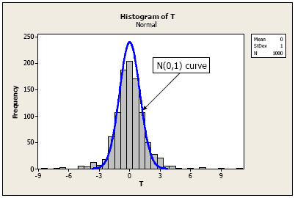
Step 5: Look up t in the chart
Does our computed t fall in the critical region (beyond the critical value), for its degrees of freedom (n-1)?

Slide 14
Step 6: Decide what to conclude
If no (it does not fall beyond the critical value), we fail to reject the Null Hypothesis.
If yes (it falls beyond the critical value), we can reject the null hypothesis. Our probability of Type I error will be less than 0.05 (or whatever we set as alpha). We can say that our result was statistically significantly different from the baseline we were testing.

